Slide 1
What is a VLAN?
A VLAN (virtual LAN) is a subnetwork which can group together collections of devices on separate physical local area networks (LANs).
VLANs make it easy for network administrators to partition a single switched network to match the functional and security requirements of their systems without having to run new cables or make major changes in their current network infrastructure.
VLANs are also important because they can help improve the overall performance of a network by grouping together devices that communicate most frequently. VLANs also provide security on larger networks by allowing a higher degree of control over which devices have access to each other. VLANs tend to be flexible because they are based on logical connections, rather than physical.

Slide 2
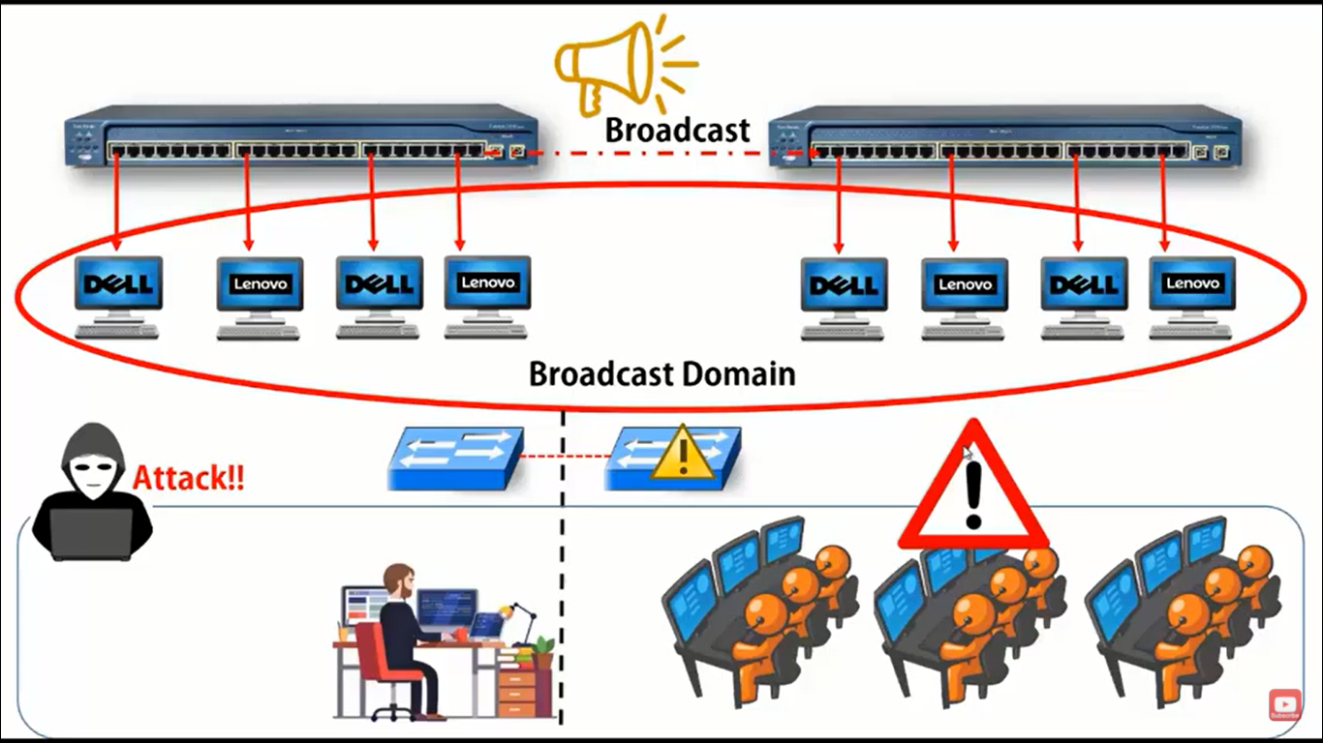

Slide 3
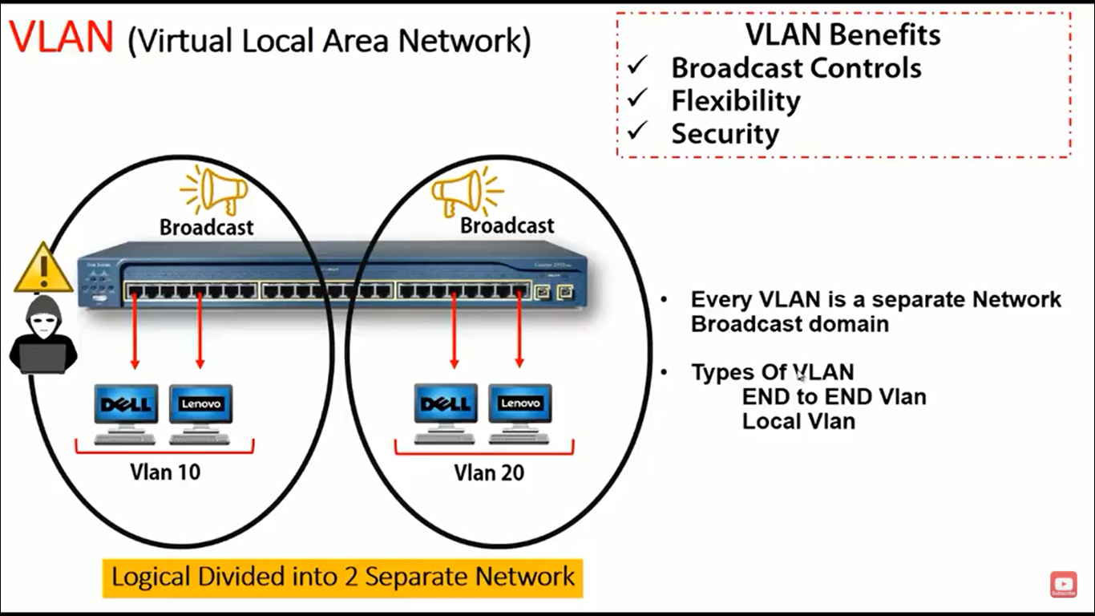

Slide 4
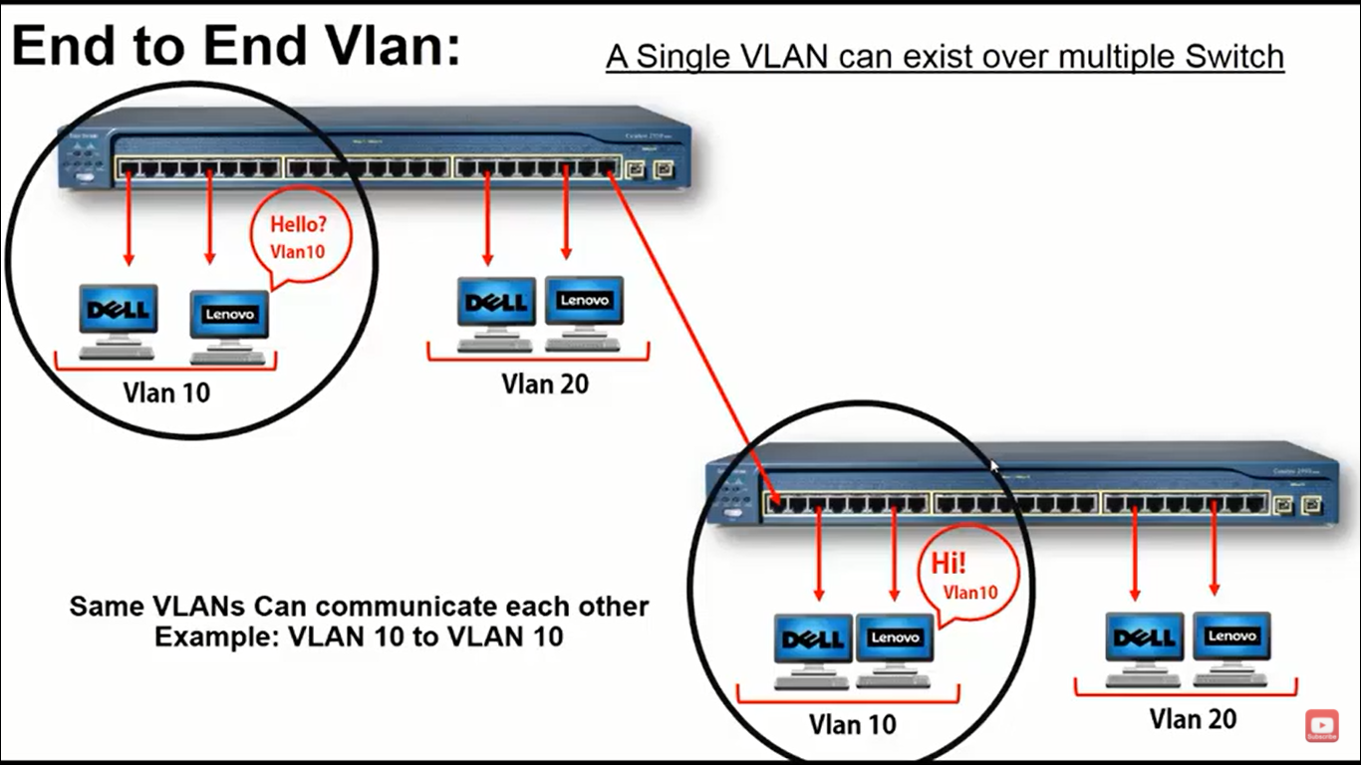

Slide 5
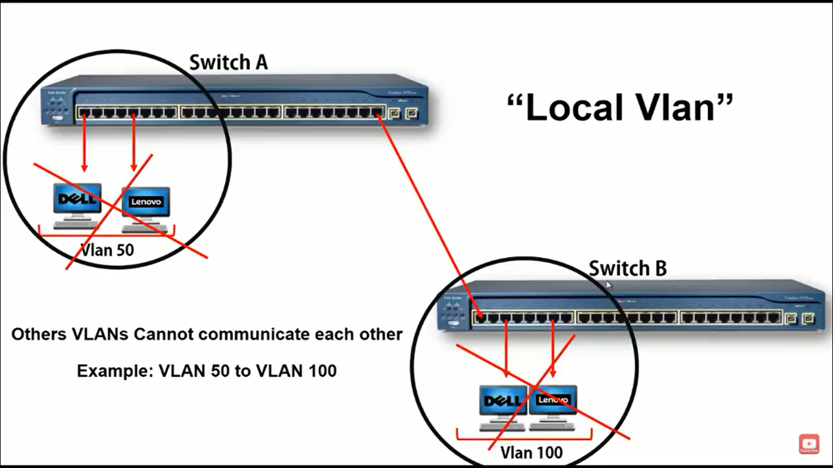

Slide 6
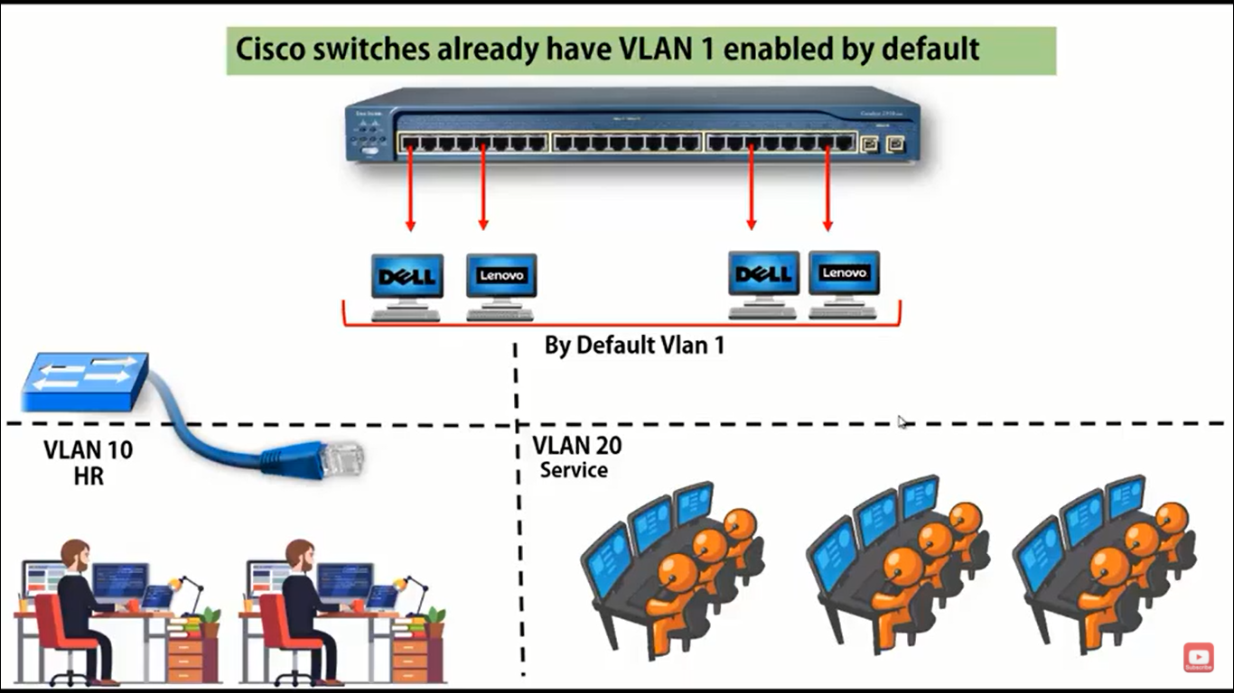

Slide 7
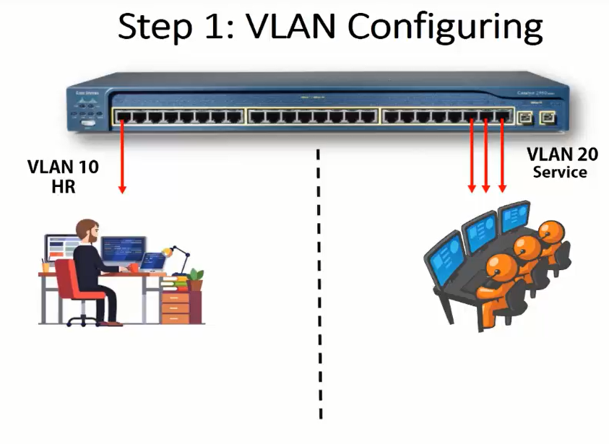

Slide 8
VLAN Configuration Commands
1. Switch>enable //Move to privilege mode
2. Switch#configure terminal // Move to Global Configuration mode
Enter configuration commands, one per line. End with CNTL/Z.
3. Switch(config)#host UIIT //Change the default name of switch
4. UIIT(config)#exit
5. UIIT# //Name Changed Successfully
6. UIIT#show run //Show switch settings
7. 3. Switch(config)#vlan ? //how many number of vlan possible

Slide 9
VLAN Configuration Commands Cont.…
7. UIIT(config)#vlan 10 //Creating Vlan 10
8. UIIT(config-vlan)#name HR //Assigning Name to Vlan
9. Switch(config-vlan)#exit //Move to one step back
10. Switch(config)#exit //Move to Privilege mode
………………………………………………………………………………………………………………
11. UIIT(config)#vlan 20 //Creating Vlan 20
12. UIIT(config-vlan)#name Services //Assigning Name to Vlan
13. UIIT(config-vlan)#exit //Move to one step back
14. UIIT(config)#exit //Move to Privilege mode
15. UIIT#show vlan //Show available vlans

Slide 10
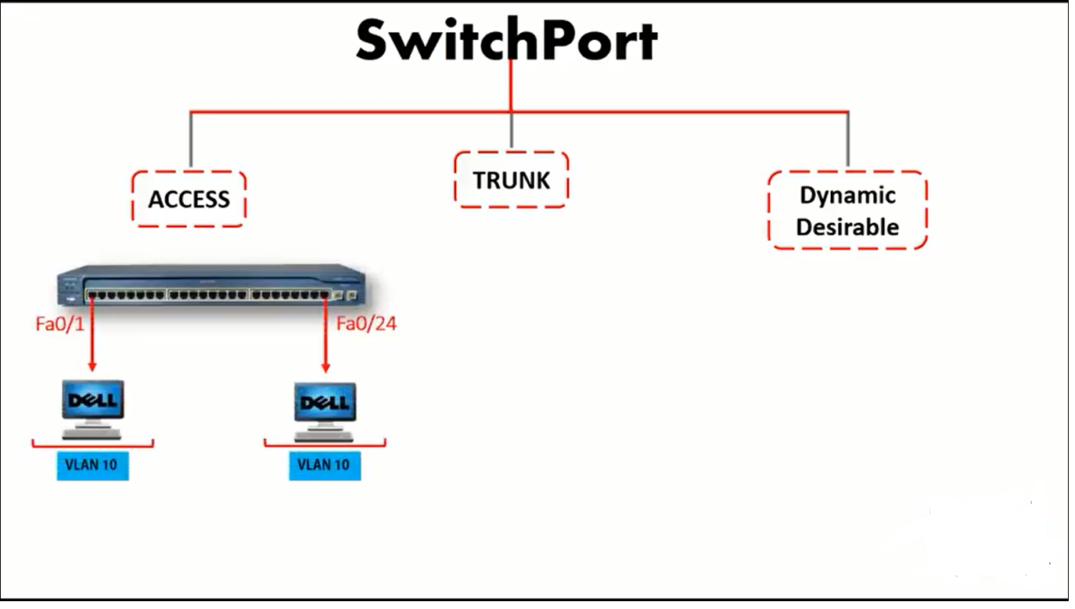
Access Port just transfer the data to specific VLAN

Slide 11
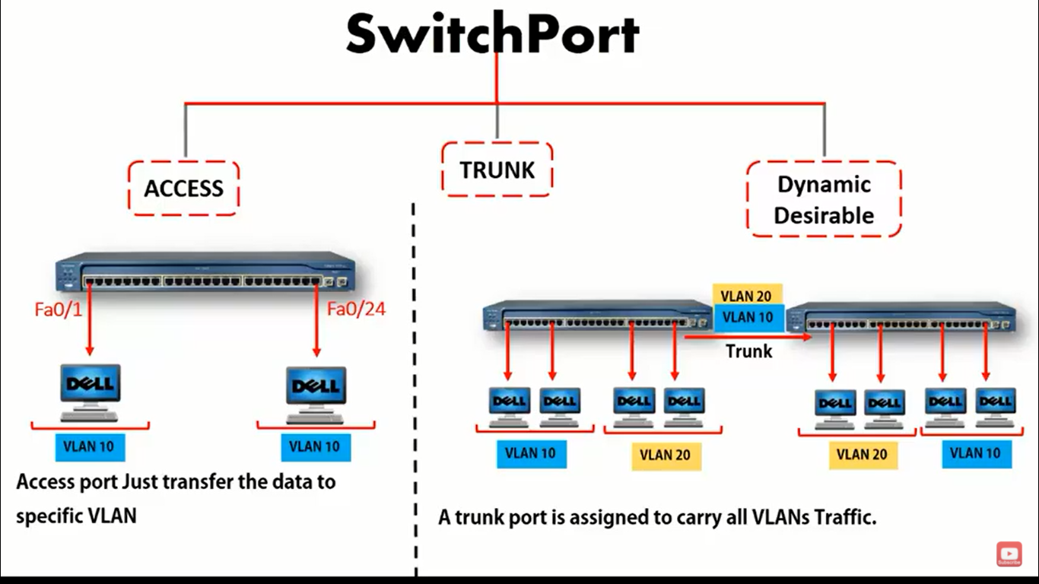

Slide 12
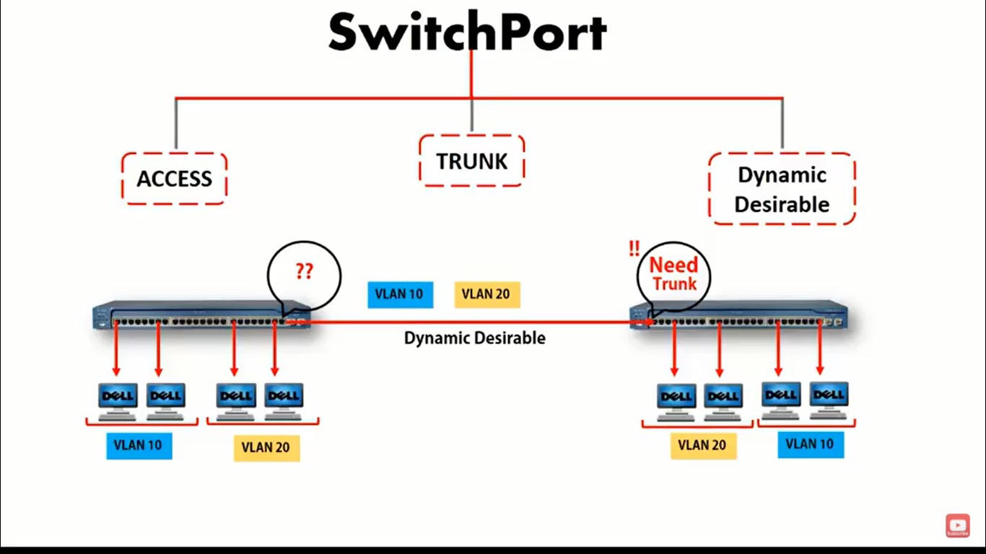

Slide 13
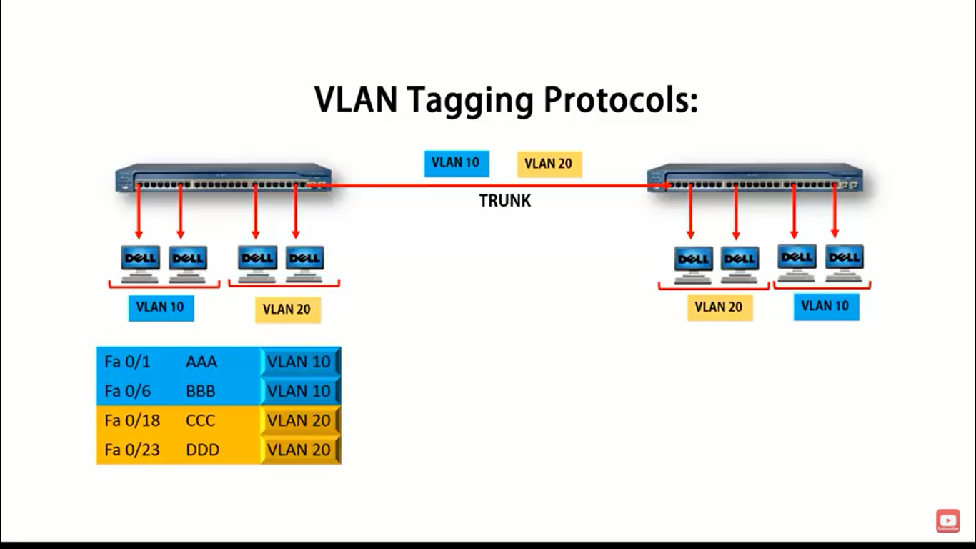

Slide 14
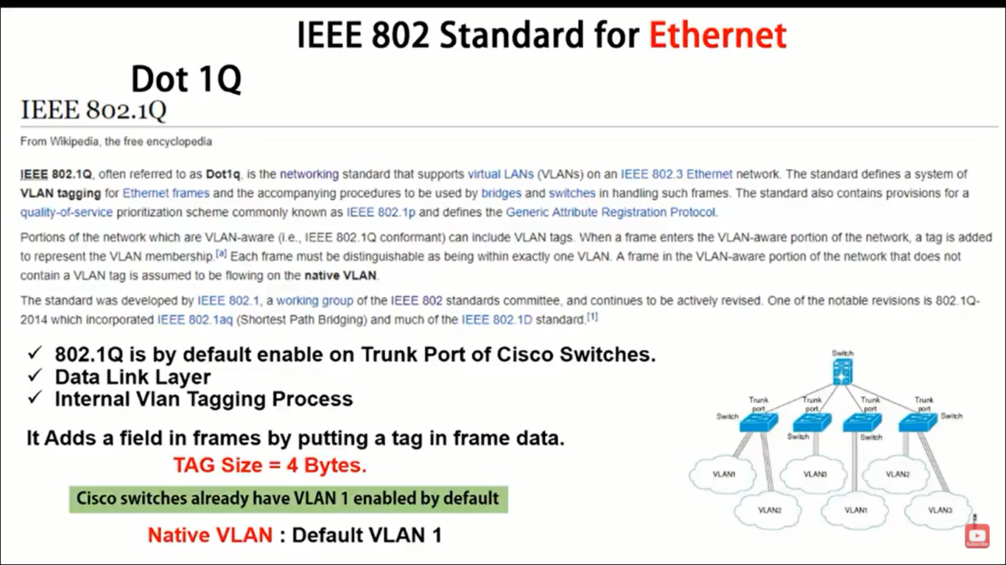

Slide 15
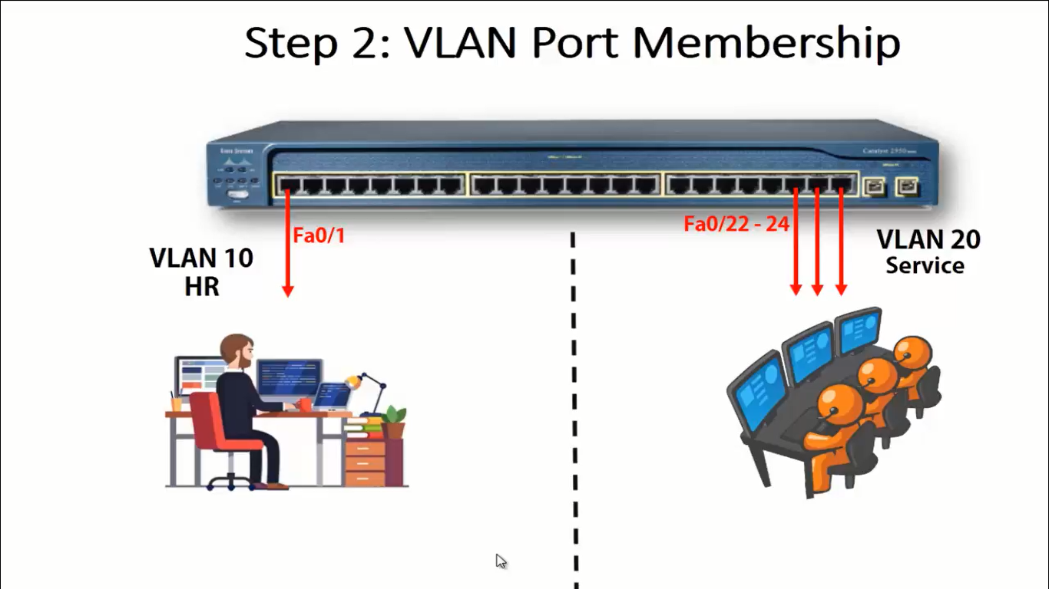

Slide 16
Assigning Ports to VLAN
To get traffic of all VLAN’s *
\\ create all vlans same like you created in other switches
Vlan 10
Vlan 20
Vlan 30
Assign single interface ports to VLAN
Interface fa 0/2
Switchport mode access
Switchport access vlan 10
Interface fa 0/1
Switchport mode access
Switchport access vlan 20
Interface fa 0/3
Switchport mode access
Switchport access vlan 30
To Assign more than one interface ports in same VLAN
Switch>enable
Switch#conf ter
Switch(config)#vlan 10
Switch(config-vlan)#name UIIT
Switch(config-vlan)#interface range fa 0/1-10
Switchport mode access
Switchport access vlan 10
Switch(config-if-range)#exit
Switch(config)#exit
Switch#

Slide 17
Assigning Trunk Ports
To make port trunk
Switch>enable
Switch#conf ter
Switch(config)#int fa 0/24
Switch(config-if)#switchport mode trunk
Switch#show vlan
Switch#show int trunk
Class Task: After the successful completion of lab practical class
Teacher will Provide task to assess the students. See next slide

Slide 18
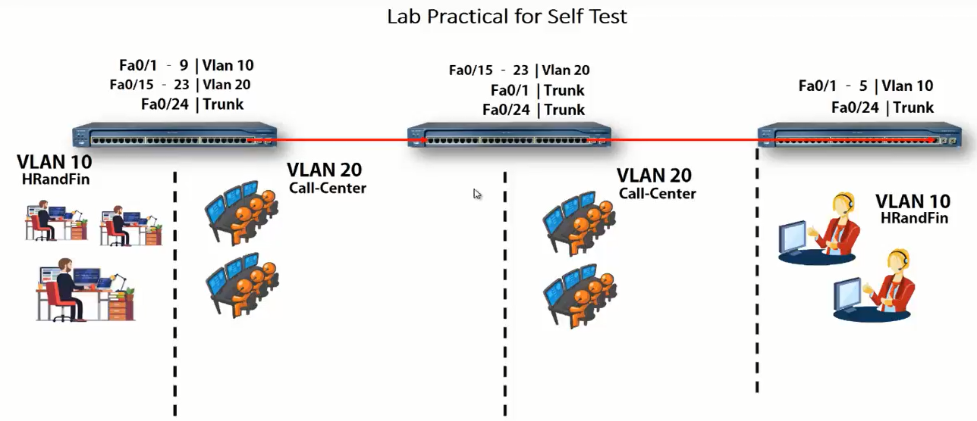

Slide 19
Delete VLAN
To delete interfaces manually from vlan
Switch(config)#interface range fastEthernet 0/1-10
Switch(config-if-range)#no switchport access vlan 10
Switch(config-if-range)#exit

